Slide 1


Online Toll Gate Application
Presented by:
Tejaswi Reddy K
192371036
Course code and Name:
CSA4307
Internet Programming For Client Server Model.

Slide 2
Introduction
Overview of the Project
The rapid growth in vehicular transportation has increased the demand for efficient traffic and toll management systems. The Online Toll Gate Application aims to digitize and automate the toll payment process to reduce human effort, time delays, and congestion at toll plazas. This application allows vehicle users to register, link their vehicle and payment information, and automatically pay tolls as they pass through toll gates. With features like real-time toll deductions, travel history, and digital receipts, the system enhances user convenience and promotes a cashless, paperless ecosystem.
Problem Statement
Traditional toll collection systems often involve:
Manual payment processes, resulting in long queues, delays, and inefficiencies.
Increased fuel consumption and emissions due to vehicle idling.
Lack of transparency in toll charges and transaction history.
Purpose of the Project
The purpose of the Online Toll Gate Application is to
Automate the toll collection process to reduce congestion and wait times,
Enhance transparency by providing real-time toll transaction records to users,
Minimize human intervention to reduce errors and operating costs.

Slide 3
Objectives
Clear Goals:
Automate Toll Collection Process: Enable automatic toll deduction through digital platforms.
Enhance User Convenience: Allow users to pre-register their vehicles and payment details.
Reduce Traffic Congestion: Improve the flow of traffic through faster processing.
Integrate with Vehicle and GPS Systems: Use vehicle registration details and GPS for location-based toll calculation.
Expected Outcomes:
Faster Toll Processing
Improved Traffic Management
User Satisfaction
Reduced Operational Costs
Environmentally Friendly Solution

Slide 4
Literature Review / Background
1. Data Sources:
The development and evaluation of the Online Toll Gate Application are grounded in:
Government reports and whitepapers on national highway and toll management systems.
Research journals on Intelligent Transportation Systems (ITS) and Electronic Toll Collection (ETC).
User feedback and traffic congestion statistics from toll plazas.
Technological surveys on IoT, RFID, GPS, and online payment gateway systems.
2. Based on Research Studies:
Several studies and implementations have explored toll management solutions:
Electronic Toll Collection (ETC) systems using RFID and DSRC have been widely adopted, demonstrating reduced wait times and increased toll booth efficiency.
Studies in IEEE Xplore and ScienceDirect show the positive impact of digital toll systems on reducing vehicle emissions and traffic bottlenecks.
Research confirms the importance of real-time transaction updates and system interoperability in enhancing user experience and system reliability.
3. Research Gap:
Many studies focus on hardware solutions (e.g., RFID, sensors) without integrating user-centric mobile/web platforms.
A lack of unified systems that combine vehicle registration, payment processing, toll history, and route planning.
Limited attention has been paid to user interface design, multi-language support, or payment flexibility.

Slide 5
Literature Review / Background
4. Problems in Previous Studies:
System scalability issues in handling high volumes of users and toll transactions.
Technical failures such as tag misreads or network downtime at booths.
User dissatisfaction due to lack of transparency or difficulty in accessing toll history.
Dependency on physical infrastructure such as RFID gates which increases cost and limits portability.
Limited integration with modern digital payment methods and mobile-first platforms.
5. Why Use Online Toll Gate Application?
The Online Toll Gate Application is proposed as a modern solution to overcome these gaps:
Mobile and Web-based Platform: Accessible from anywhere, anytime.
Real-Time Transactions: Immediate toll deductions and updates to users.
Digital Wallet and UPI Integration: Flexible and secure cashless payment options.
Transparent Toll History: Full access to past toll receipts, routes, and costs.
Improved User Experience: Intuitive UI/UX design, multi-language support, and account personalization.
Scalable and Cost-effective: Minimizes physical infrastructure and human resources by relying on cloud-based services and automation.

Slide 6
Methodology
Tools & Frameworks Used
Front End – HTML,CSS
Back End – PHP
Database – My SQL
Xamp for Integration
Development Approach Developed using the Agile Software Development Lifecycle (SDLC).The process begins with requirement analysis to understand user needs and system functions. In the design phase, UI wireframes and backend architecture are planned. Frontend is built using HTML, CSS, JavaScript, and React.js for a responsive interface. The backend is developed using PHP, managing APIs and logic. Restful APIs are used for smooth communication between frontend and backend.
Data Collection The application collects user data (name, contact, vehicle info) during registration. Toll transaction details like time, location, amount, and payment status are recorded in real time. Toll booth data, including rates and locations, is integrated into the backend system. Secondary data from government sources is used for testing and validation. All data ensures secure, transparent, and efficient toll processing.

Slide 7
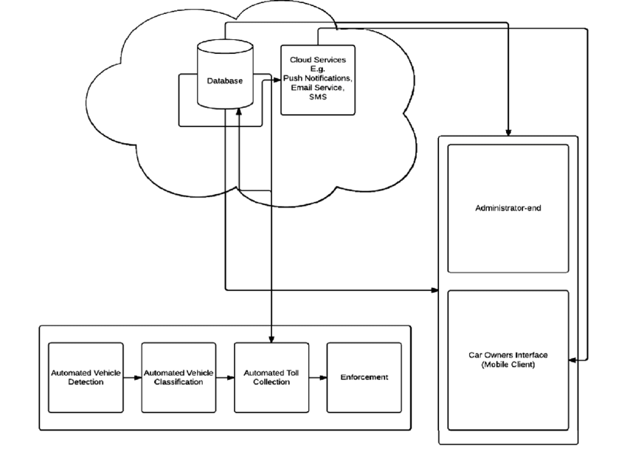
System Design / Architecture

Slide 8
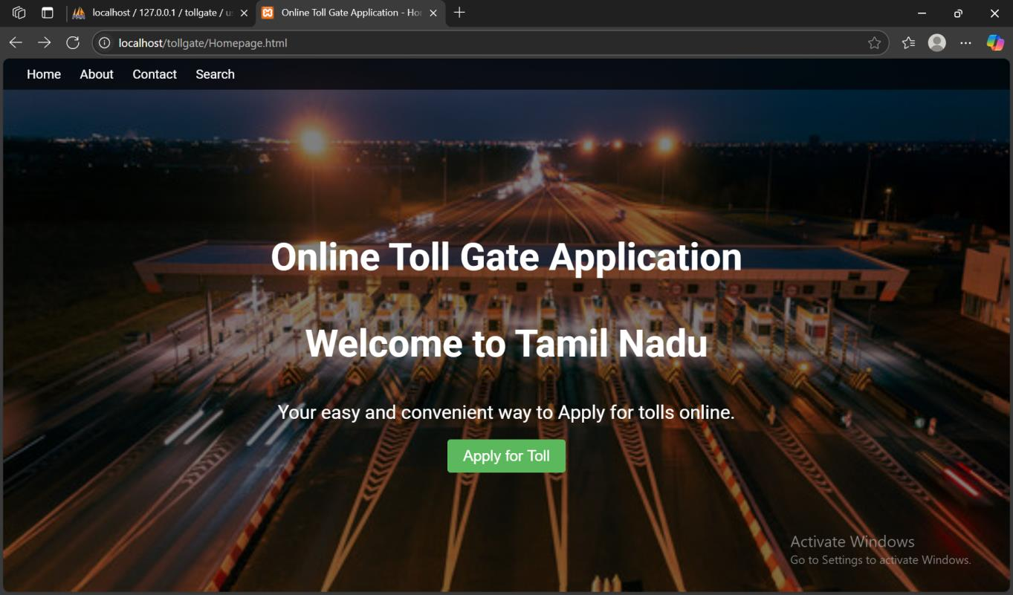
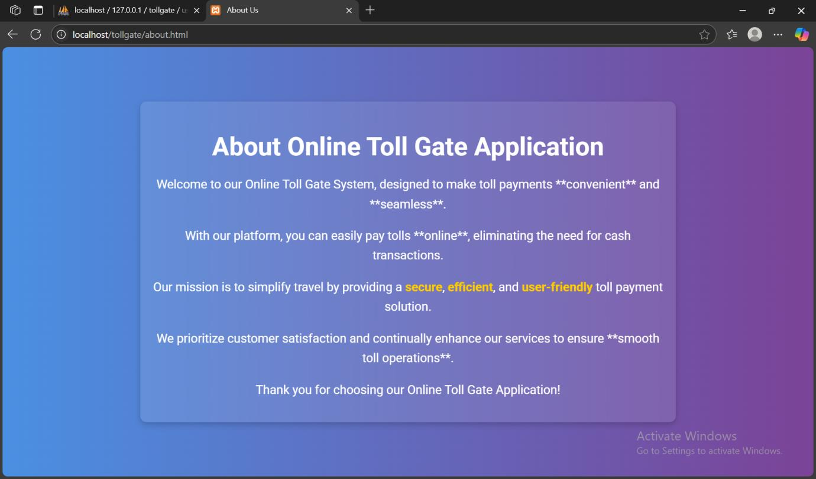
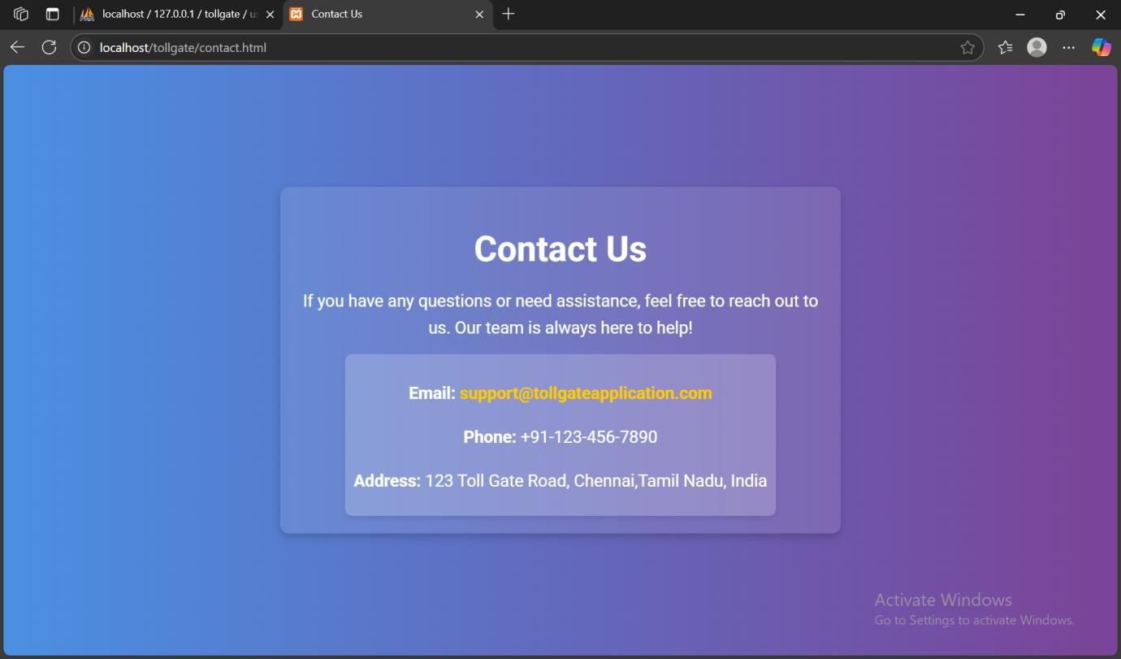
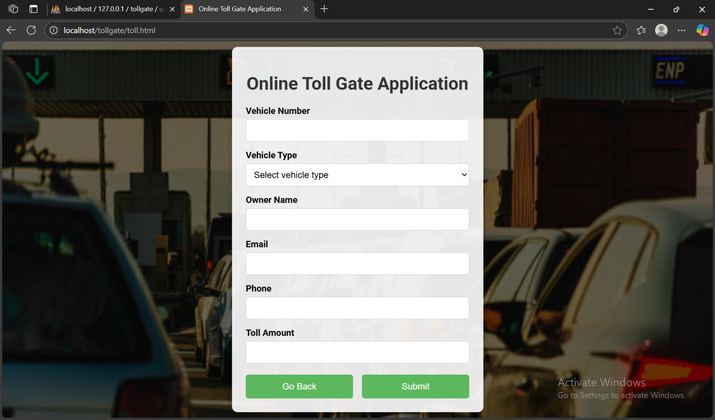
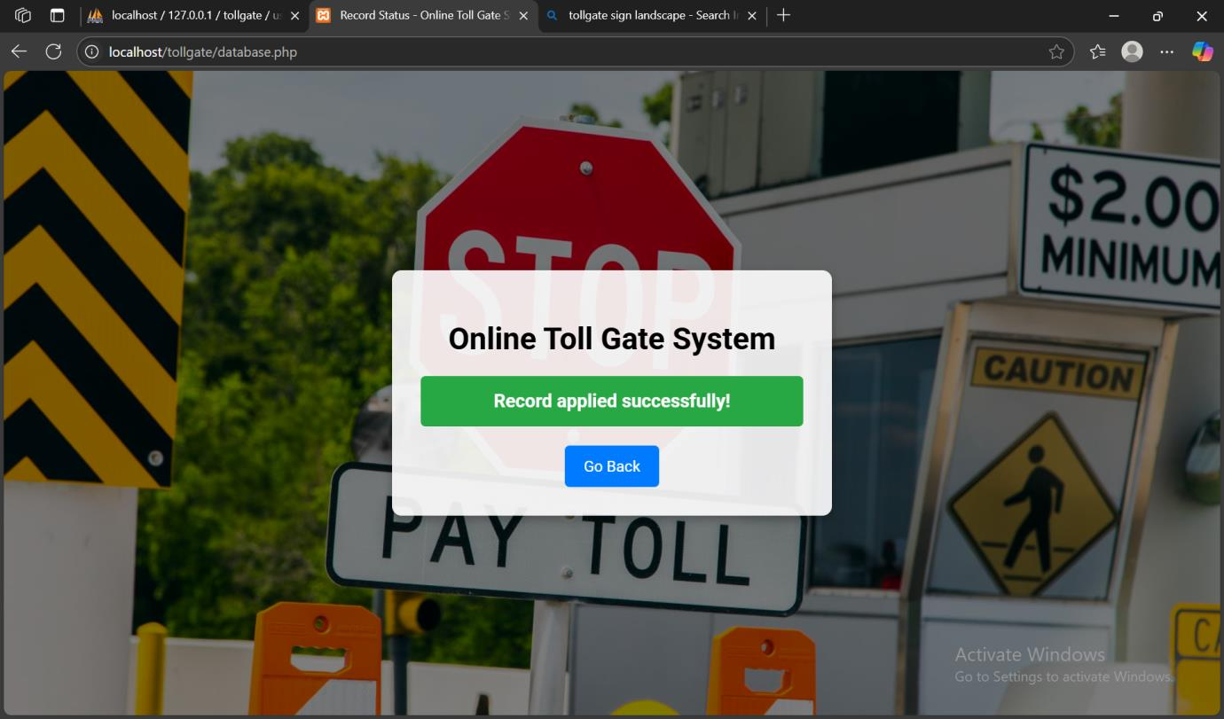
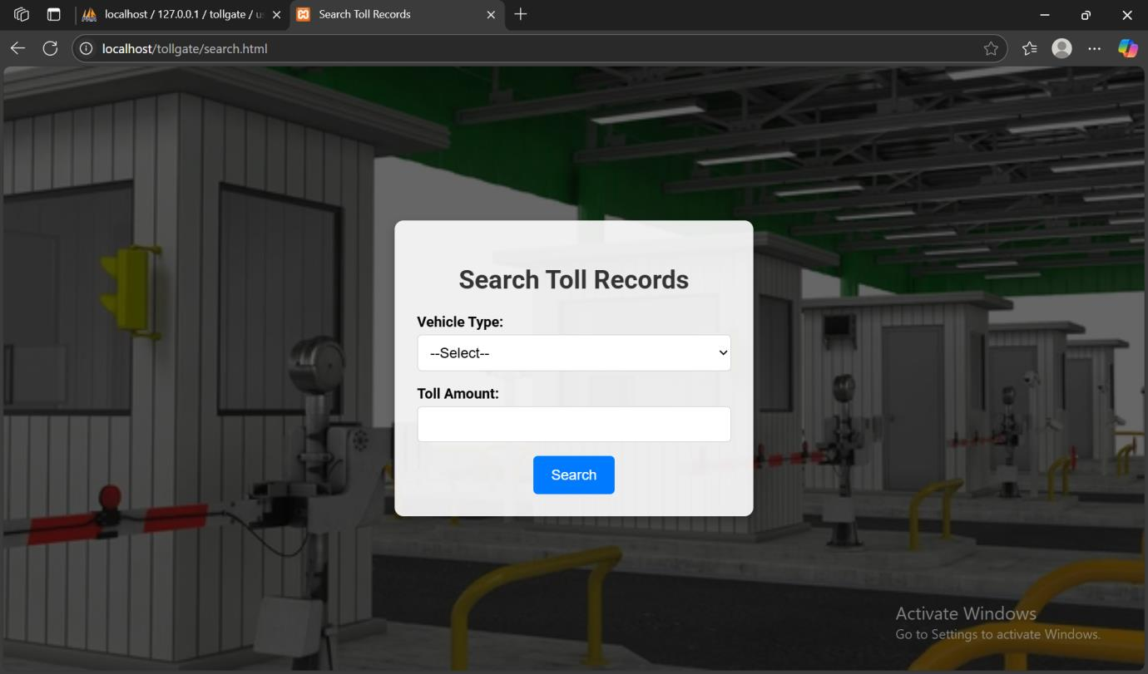
Results & Discussion

Slide 9
Challenges & Limitations
Issues Faced During Development
User Authentication & Security: Securing user data and sessions with JWT/OAuth added extra layers of logic and required careful implementation to avoid vulnerabilities.
System Scalability: Designing a system capable of handling multiple users and toll booth requests simultaneously required load testing and performance tuning.
Testing in Realistic Scenarios: Simulating real toll data (vehicle crossings, multiple toll booths, high traffic) was difficult without live access to actual toll infrastructure.
Possible Constraints
Network Dependency: The system relies heavily on stable internet connectivity for processing real-time toll transactions.
Hardware Integration: Full automation (e.g., RFID or ANPR vehicle detection) depends on expensive hardware which may not be readily available.
Legal & Regulatory Compliance: The application must comply with transport department regulations, which may vary by region and require continuous updates.
User Adoption: Encouraging users to shift from manual toll payments to a digital system could be a challenge, especially in rural areas.
Data Privacy: Storing sensitive user and vehicle data requires strict compliance with data protection laws (e.g., GDPR or local equivalents).

Slide 10
Future Scope
Enhancements or Improvements
Integrating RFID and ANPR (Automatic Number Plate Recognition) technology can automate vehicle detection, reducing the need for manual input and speeding up toll processing.
Adding GPS-based toll mapping will allow users to receive real-time updates on upcoming tolls and charges based on their current location and route. Implementing AI-driven traffic prediction can help optimize toll booth operations during peak hours.
Furthermore, integrating blockchain technology could enhance transparency and security of toll transactions. These improvements will make the application more robust, user-friendly, and future-ready.
How This Project Can Be Extended Further
One major extension is the integration of IoT-enabled toll barriers that automatically open upon successful digital payment verification, fully eliminating human intervention.
Another extension could be the inclusion of a vehicle tracking module for fleet management, enabling logistics companies to monitor toll expenses and vehicle movements in real-time.
Additionally, a government dashboard could be developed to allow transport authorities to monitor toll data, identify traffic patterns, and make data-driven infrastructure decisions.
Finally, the system could be expanded to support carbon tracking and encourage eco-friendly vehicle usage by offering incentives for electric or low-emission vehicles.

Slide 11
Conclusion
Summary of the Project The Online Toll Gate Application is a smart, digital solution designed to automate and streamline toll collection processes on highways and expressways. It aims to eliminate manual toll transactions, reduce traffic congestion, and enhance user convenience through a web and mobile-based platform. Users can register their vehicles, make cashless toll payments, and view their transaction history in real time. The system is developed using modern technologies such as HTML and CSS for the frontend and PHP for the backend, with secure database management. Key features include user authentication, vehicle data management, toll calculation, and real-time transaction logging. Overall, the project demonstrates a practical application of technology in improving public infrastructure and user experience.
Key Takeaways
Automation Enhances Efficiency: Digital toll collection significantly reduces manual work, wait times, and traffic congestion.
User-Centric Design Matters: A simple, intuitive interface improves user engagement and ease of payment.
Real-Time Data is Powerful: Instant updates and live transaction logs enable transparency and effective monitoring for both users and toll authorities.
Research-Based Development Helps: Analyzing previous studies and identifying gaps led to a more robust and relevant solution.
Scope for Expansion: The project has strong potential for future enhancements like RFID integration, fleet management, and environmental incentives.
Tech for Good: This solution shows how technology can improve public infrastructure and user experience on a large scale.

Slide 12
References
Nousheen, I., Kancharla, J., & Jyothsna, P. (2023). Tollgate App for Online Based Payment. International Journal of Management Research and Business Strategy, 13(3), 121-127.
Jebaraj, B. S., Nasreen, M. A., Sushmitha, S., Azarudeen, K., Subha, T. D., & Vivekrabinson, K. (2024, July). Enhancing Road Safety and User Experience through Intelligent Tollgate Systems and Vehicular Communication Networks. In 2024 5th International Conference on Image Processing and Capsule Networks (ICIPCN) (pp. 935-940). IEEE.
Sarkar, S., Selvabharathi, M., Sarveswaran, D., & Raju, A. (2024, October). Boothless Toll Collection System. In 2024 International Conference on Power, Energy, Control and Transmission Systems (ICPECTS) (pp. 1-7). IEEE.
Syafei, W. A., Fatkhurrahman, M. A., Baharuddin, Y., Hidayatno, A., & Ochi, H. (2018, November). Queuing free smart toll gate based on wireless technology. In 2018 International Symposium on Intelligent Signal Processing and Communication Systems (ISPACS) (pp. 24-30). IEEE.
Sharma, D., Anawade, P., & Gahane, S. (2025). Driving Toward Tomorrow: A Comparative Study of Electronic Toll Collection and Satellite-Based Tolling. ICT Analysis and Applications: Proceedings of ICT4SD 2024, Volume 4, 1162, 81.
RaviKiran, D. N., Swetha, G., Annapurna, D. L., Teja, C. V., & Karthik, A. IoT Based Advanced Automatic Toll Collection and Vehicle Detection System.

Slide 13
Thank You!

